Slide 1
Place of Worship Security & Safety Training
CHOWAN COUNTY SHERIFF’S OFFICE
911 emergency
252-482-8484 non emergency

Slide 2
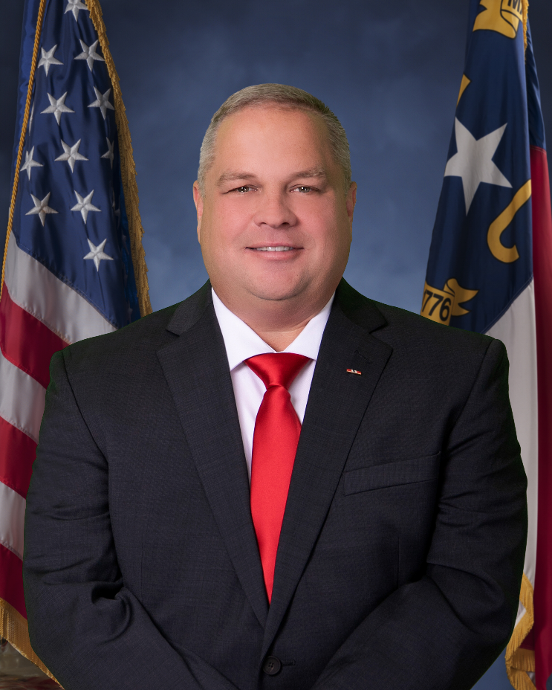
Place of Worship Security & Safety Training
Chowan County Sheriff
Edward Basnight

Slide 3
Place of Worship Security & Safety Training
Purpose:
To provide reasonable measures of safety to confront various threats and emergencies that places of worship may face during the hours of worship.
To have an open line of communication and community outreach.
To attempt to ensure a safe and welcoming environment for all individuals eager to worship in our county.

Slide 4
Place of Worship Security & Safety Training
This presentation should not be relied upon as legal advice and is designed as a guide only.
You should consult with your own legal advisor prior to implementing a particular plan.

Slide 5
Place of Worship Security & Safety Training
Why conduct training for your place of worship?
According to recent studies, 1,617 deadly force incidents and 759 deaths have occurred on church or religious properties since 1999.
Source: “Security? In a Church?”
Carl Chinn - cdchinn@msn.com
Notes:
210 more deaths. What a jump in last two years
600 more deadly force incidents in last two years

Slide 6
Place of Worship Security & Safety Training
Motivational Factors Behind the Attack:
Domestic Violence
Evil intent
Hate (various biases)
Mental illness

Slide 7
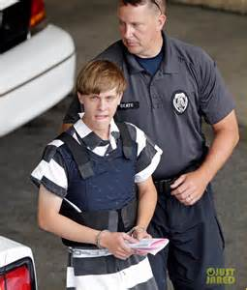
Place of Worship Security & Safety Training
Church Massacre Suspect Held as Charleston Grieves
June 18, 2015
CHARLESTON, S.C. — The mass murder of nine people who gathered Wednesday night for Bible study at a landmark black church has shaken a city whose history from slavery to the Civil War to the present is inseparable from the nation’s anguished struggle with race. Fourteen hours after the massacre, the police in Shelby, N.C., acting on a tip from a motorist, arrested Dylann Roof, a 21-year-old white man with an unsettled personal life and a recent history of anti-black views. The killings, with victims ranging in age from 26 to 87, left people stunned and grieving.
Dylan Roof was convicted and sentenced in Federal Court
By: Nick Corasaniti, Richard Perez-Pena and Lizette Alvarez
Source:http://www.nytimes.com/2015/06/19/us/charleston-church-shooting.html

Slide 8
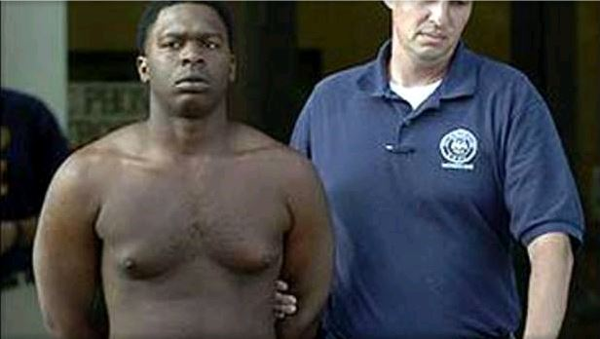
Place of Worship Security & Safety Training
5 Dead in Louisiana Church Shooting
May 21, 2006
A man opened fire Sunday morning at a church hitting five people, four of them fatally before abducting his wife, whom he later shot to death at another location, authorities said. The suspect, Anthony Bell, 25, of Baton Rouge, was captured at an apartment complex near the church. Three children abducted with the woman were all found safe.
Anthony Bell was convicted in April of 2008 By: James Klatell
Source: www.cbsnews.com/news/5-dead-in-louisiana-church-shooting

Slide 9
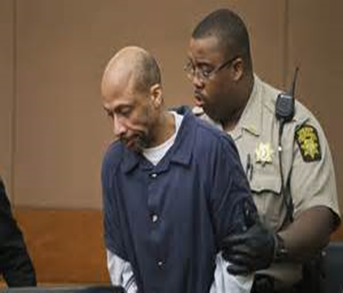
Place of Worship Security & Safety Training
Area Pastors Say Church Shooting Outside Atlanta Should Serve as a Warning
October 25, 2012
About 20 people were gathered for a Wednesday morning prayer service at the 30,000-member World Changers Church in College Park, Ga., where Atlanta police say a 52-year-old former maintenance man walked into the sanctuary and fatally shot a church volunteer. Atlanta police identified the suspect as Floyd Palmer, who worked in the facilities department at the church until August. He was taken into custody late Wednesday. Officials suggested that Palmer suffers from mental illness. The incident is prompting church leaders from Atlanta to Washington to examine their security.
By: Hamil Harris
Source:https://www.washingtonpost.com/blogs/therootdc/post/church-shooting-outside-atlanta

Slide 10
Place of Worship Security & Safety Training
At least 26 dead in Sutherland Springs, Texas church shooting
At least 26 are dead and 20 are injured after a man dressed in black entered First Baptist Church in Sutherland Springs, Texas armed with a rifle and opened fire on its congregation Sunday, Gov. Greg Abbott said at a press conference.
Those shot range from 5 to 72 years old, officials said at the conference. Abbott called it the "worst mass shooting" in the state's history.
By: (Sinclair Broadcast Group) The Associated Press
Source:http://wjla.com/news/nation-world/multiple-injuries-reported-at-a-church-shooting-in-sutherland-springs-tex

Slide 11
Place of Worship Security & Safety Training
North Carolina Sheriffs’ Association’s
Place of Worship Security & Safety Guide

Slide 12
Place of Worship Security & Safety Training
“This training's purpose is to mentally prepare the citizens of Chowan County for an active shooter type emergency. It is important to have a plan of action for this and other types of emergencies, so that when something happens you react more efficiently and the likelihood of the individual surviving the encounter greatly increases. The training has a real potential to prevent an active shooter from choosing to make entry into our places of worship or other large gathering areas.”
--Chowan County Sheriff Dwayne Goodwin (2006-2020)
“A place of worship should be a place of peace and a safe haven for worshipping away from conflicts of the world.”
--Sheriff Hubert A. Peterkin, Hoke County Sheriff
2015 – 2016 NCSA President

Slide 13
Place of Worship Security & Safety Training NCSA Place of Worship Security Guide
The purpose of this guide is to provide direction for places of worship regarding reasonable measures of safety to confront various threats and emergencies they may face during the hours of worship.
It discusses actions that may be taken before, during, and after an incident in order to reduce the impact on people, property, and loss of life.

Slide 14
Place of Worship Security & Safety Training
Prevention
Place of Worship Planning and Oversight Committee
Who: Pastoral staff, elders, deacons, key congregational members (i.e. law enforcement personnel, EMS, fire, military, lawyers, counselors, doctors).
Goal: To provide a forum for developing, implementing and continually refining a planning process to address the safety needs of your place of worship before, during, and after a critical incident.

Slide 15
Place of Worship Security & Safety Training
Prevention
Place of Worship Planning and Oversight Committee
Objectives:
Complete a security risk assessment to include the facility, policies and procedures, business practices, and operations.
Adopt a security plan.
Assemble a security team and appoint a Security Team Leader to implement the plan.
Coordinate training and education for the congregation.

Slide 16
Place of Worship Security & Safety Training
Prevention
Security Risk Assessment of your Place of Worship
Who: Sheriff, local law enforcement, fire and rescue, and private consultants.

Slide 17
Place of Worship Security & Safety Training
Prevention
Security Risk Assessment of your Place of Worship
Goal: To assess the existing risks, threats, and vulnerabilities of your place of worship including:
Facility;
Staff and volunteers;
Congregation demographics;
Childcare protection protocol;
Surrounding community threats;
Communications (internal and external);
Policies and procedures; and
Handling of money during worship services.

Slide 18
Place of Worship Security & Safety Training
Prevention
Place of Worship Security Plan
Who: Place of worship security team in collaboration with community partners (i.e. government entities that have responsibility in the plan, including first responders such as law enforcement, fire and EMS).
Goal: To adopt a basic plan of operation before, during, and after a critical incident in a place of worship during a time of worship.

Slide 19
Place of Worship Security & Safety Training
Prevention
Place of Worship Security Plan
Framework:
a. Basic facility security measures should include:
Facility blueprints
Cameras and alarms
Locked and unlocked doors and windows
Exterior lighting

Slide 20
Place of Worship Security & Safety Training
Prevention
Place of Worship Security Plan
b. Establish the role of the security team before, during, and after a critical incident:
Communications (internal and external)
Preparation drills
Role of greeters
Perimeter and parking lot monitoring
Placement of security team members in facility during time of worship
Childcare protocol

Slide 21
Place of Worship Security & Safety Training
Prevention
Place of Worship Security Plan
Duties during a critical incident:
- 911 call
- Coordinate evacuation or lockdown procedures
- Confront the threat
- Managing the safety zones
- Point of contact (POC) with first responders
- Assist first responders

Slide 22
Place of Worship Security & Safety Training
Prevention
Place of Worship Security Plan
c. Establish an evacuation procedure
d. Establish a lockdown protocol
e. Adopt a Crisis Intervention Stress Management (CISM) strategy
f. Analyze congregation demographics (i.e. number of children, senior citizens, people with disabilities, people with criminal backgrounds such as sex offenders)

Slide 23
Place of Worship Security & Safety Training
Prevention
Place of Worship Security Plan
g. Implement a firearms policy that specifies who, if anyone, can or cannot carry a firearm into a place of worship.
The available options are:
Allow all concealed carry with a concealed carry permit
Restrict concealed carry to designated personnel
Prohibit all persons from carrying firearms, open carry or concealed carry
Allow any person who can lawfully possess firearms to carry them openly on the premise.

Slide 24
Place of Worship Security & Safety Training
Prevention
Note: North Carolina General Statute § 14-415.11 authorizes the church to post signs, as any other private property, prohibiting the possession or carrying of firearms. But, if not otherwise posted, anyone who has obtained their concealed carry permit under North Carolina General Statute § 14-415.24 may carry on church property, unless possession of the firearm is otherwise prohibited by law (e.g. if the church is on school grounds). Similarly, a church would have the authority to allow firearms to be openly carried on the premise so long as the possession of firearms is not otherwise prohibited by law (e.g. if the church is on school grounds).

Slide 25
Place of Worship Security & Safety Training
Prevention
Special Circumstances:
If church services are held on any school property (public, charter or private), the law governing the possession of firearms on school grounds (North Carolina General Statute § 14-269.2) would apply.
If circumstances require a school program to be held on church property, the law governing the possession of firearms on school grounds (North Carolina General Statute § 14-269.2) would apply to the area where the school program is taking place because this would be a curricular or extracurricular activity sponsored by a school. Other areas of the church property not being used for the school program would continue to be regulated by the church authority as set out in the “Note” above.

Slide 26
Place of Worship Security & Safety Training
Prevention
Special Circumstances (continued):
If a religious organization operates a school and a church is also located on this property, then the law governing the possession of firearms on school grounds (North Carolina General Statute § 14-269.2) would apply.
If a church operates a daycare on church property, the church (being private property) may choose whether or not to allow firearms on the premises.

Slide 27
Place of Worship Security & Safety Training
Prevention
These prohibitions on carrying firearms on school property do not apply to:
A weapon used solely for educational or school sanctioned ceremonial purposes, or used in a school approved program conducted under the supervision of an adult, whose supervision has been approved by the school authority;
Fire fighters, emergency service personnel, North Carolina Forest Service personnel, detention officers employed by and authorized by the sheriff to carry firearms and any private police employed by an educational institution, when acting in the discharge of their official duties;
Those persons exempted by N.C. Gen. Stat. § 14-269(b), such as law enforcement officers;

Slide 28
Place of Worship Security & Safety Training
Prevention
These prohibitions on carrying firearms on school property do not apply to (continued):
A armed armored car service guard; or an armed, courier service guard, when acting in the discharge of the guard’s duties and with the permission of the college or university;
A armed security guard while on the premises of a hospital or health care facility, located on educational property, when acting in the discharge of the guard’s duties with the permission of the college or university;
An employee of a school who lives on the campus and has a concealed handgun permit may keep a handgun in their private residence;

Slide 29
Place of Worship Security & Safety Training
Prevention
These prohibitions on carrying firearms on school property do not apply to (continued):
A volunteer school safety resource officer when acting in the discharge of official duties or;
A person with a concealed handgun permit, or who is exempt from obtaining a permit, can have a handgun in a closed compartment or container within the person’s locked vehicle or the handgun can be in a locked container securely affixed to the person’s vehicle. The person may also possess the concealed handgun on his/her person while in the locked vehicle on school grounds. It would be lawful for a concealed handgun permittee to remove a handgun from a vehicle on school grounds if done so in response to a life threatening situation.

Slide 30
Place of Worship Security & Safety Training
Prevention
Training and Education Strategy
Identify the audience
Staff and volunteers
Congregation
Community
Collaborative partners (sheriff’s office, local police, fire, EMS, etc.)

Slide 31
Place of Worship Security & Safety Training
Prevention
Training and Education Strategy
Determine the delivery method
Presenters, presentation style, and materials
Note: Always protect the confidentiality of sensitive security information. Share sensitive security information only on a “need to know” basis.

Slide 32
Place of Worship Security & Safety Training
During the Incident
Security Team Leader Activates the Security Plan
Designated person calls 911.
Lock down or evacuate the sanctuary depending on the threat.
Lock down or evacuate the childcare area depending on the threat.
Set up and manage safety zones.

Slide 33
Place of Worship Security & Safety Training
During the Incident
FBI “Active Shooter” Protocol Plan
Run
Hide (lockdown plan)
Fight (confronting the shooter; a last resort)
FBI VIDEO - RUN HIDE FIGHT 5:55
Texas University Avoid Deny Defend 11:33

Slide 34
Place of Worship Security & Safety Training
During the Incident
Interacting with First Responders
Law Enforcement’s first priority must be to locate and stop the person or persons posing the threat and they will not stop to help the injured. Law enforcement officers may not be able to distinguish the “good guys” from the “bad guys”.

Slide 35
Place of Worship Security & Safety Training
During the Incident
Interacting with First Responders
Congregates and staff, including the security team members, should be trained to do the following when first responders arrive:
Follow all commands such as getting down on the ground, dropping all objects (including cell phones) from hands and putting hands in the air.
Once identified and cleared, the security team should meet with first responders and provide as much information as possible (ie. location of safe zones, last known location of the threat, facility access points and childcare location and access).

Slide 36
Place of Worship Security & Safety Training
The Aftermath
Place of Worship Security Team:
Brief first responders upon arrival.
Continue to manage safe zones and assist first responders as directed.
Identify a place of worship spokesperson to address the media and public along with the first responder media spokesperson.
Coordinate all activities with first responders.

Slide 37
Place of Worship Security & Safety Training
The Aftermath
First Responders
Assume command of the critical incident.
Treat and transport injured individuals to medical facilities.
Initiate the investigation and interview witnesses.
Interview witnesses
Preserve the crime scene.
Coordinate continuing activities of the security team.
Appoint a designee to communicate with the media.
Debrief with the place of worship security team after threat is over.

Slide 38
Place of Worship Security & Safety Training
The Aftermath
Reunification Plan (responsibility of the Security Team)
Identify a safe location separate from distractions for family members trying to reunite with loved ones.
Provide family members with timely, accurate and relevant information.
Be prepared to speak with family members about what to expect when reunited with their loved ones.
Ensure effective communication with those that have language barriers or need other accommodations.

Slide 39
Place of Worship Security & Safety Training
The Aftermath
Crisis Intervention Stress Management (CISM):
Security plan should include a CISM strategy.
CISM is a comprehensive multistep crisis intervention system.
CISM consists of counseling which may be provided to individuals, small groups, large groups, families, organizations, and even communities.
Security Team Leader or designee should activate the CISM strategy immediately.

Slide 40
Place of Worship Security & Safety Training
The Aftermath
Continuity of Operations Plan (COOP):
Is your place of worship still accessible after the critical incident?
Consider a temporary relocation of your place of worship, if needed.
Analyze the impact of the critical incident on place of worship leaders, staff, and congregates to assess their ability to continue their duties.

Slide 41
Place of Worship Security & Safety Training
The Aftermath
Planning and Oversight Committee:
Review all reports filed by the Place of Worship Security Team and first responders.
Adjust security plan based on reports and lessons learned.
Update security plan and conduct new training.
Provide copies of the new security plan to all first responders within the community (i.e. sheriff, police, fire, EMS).

Slide 42
Place of Worship Security & Safety Training
Questions?
CHOWAN COUNTY SHERIFF’S OFFICE
SHERIFF EDWARD BASNIGHT

Slide 43
OUR FAMILY PROTECTING YOUR FAMILY

